Slide 1



2D Visualization with the ArcGIS API for JavaScript
Jeremy Bartley
@ArcGISJSAPI
Kristian Ekenes
@kekenes
Notes:
Esri Corporate Template-Dark v3.3
16:9 version – January 21, 2016
For more templates, sample files, and icons, see https://compass.esri.com/resources/presentations/Pages/Main.aspx
To add footer text in Windows
On the Home tab, under Insert, click Text, and then click Header and Footer.
Click the Slide tab, select the Footer check box, and then type the footer text that you want.
Click either Apply or Apply to All.
To add footer text on a Mac
On the View menu, select Header and Footer.
Select the Footer check box and then type the footer text that you want.
Click either Apply or Apply to All.
If footers don't appear on the slides
If footers don't appear on title slides, in the Header and Footer dialog box make sure the Don't show on title slide check box is not selected.
If the footers are missing from other slides, the placeholders for these items might have been removed from specific slide layouts or the slide master.

Slide 2
Feature Layer
Your gateway to client-side visualization

Slide 3
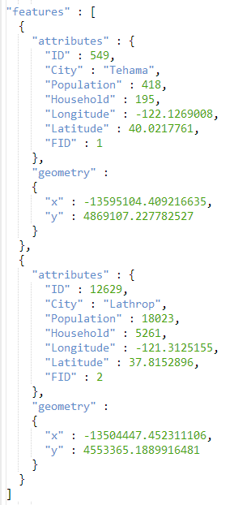
Feature Layer
Vector data (svg or canvas)

Slide 4
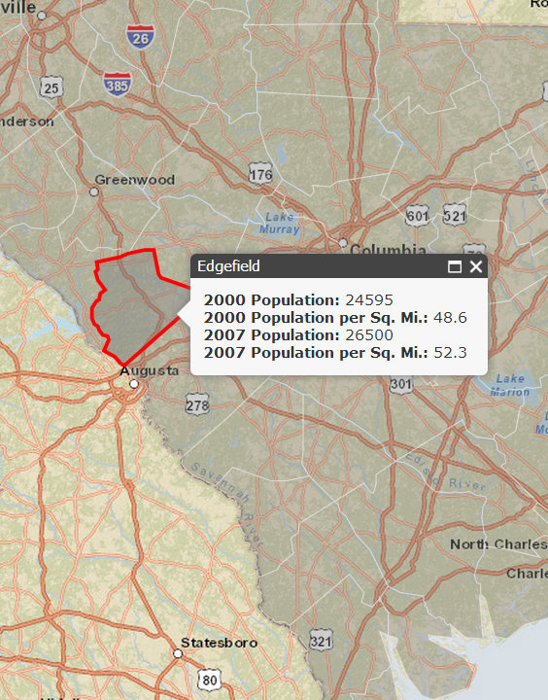
Feature Layer
Vector data (svg or canvas)
Interactive
Popups

Slide 5
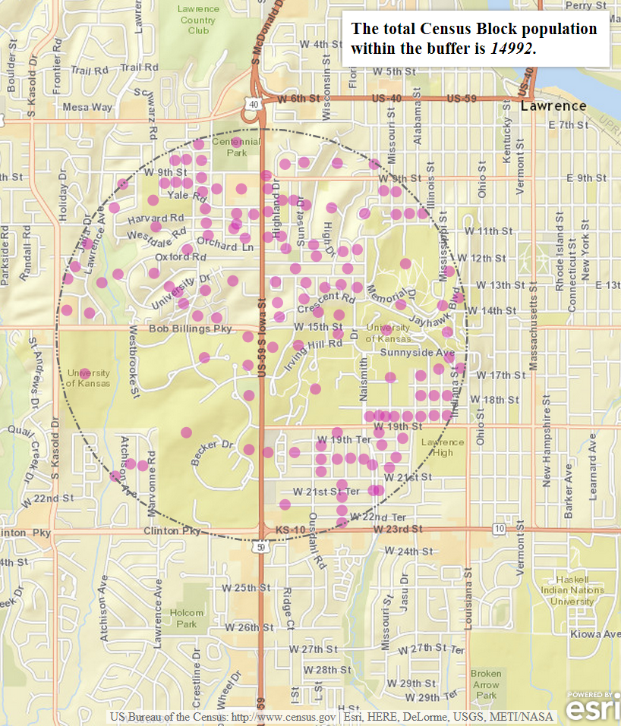
Feature Layer
Vector data (svg or canvas)
Interactive
Popups
Query (spatial and attribute)

Slide 6
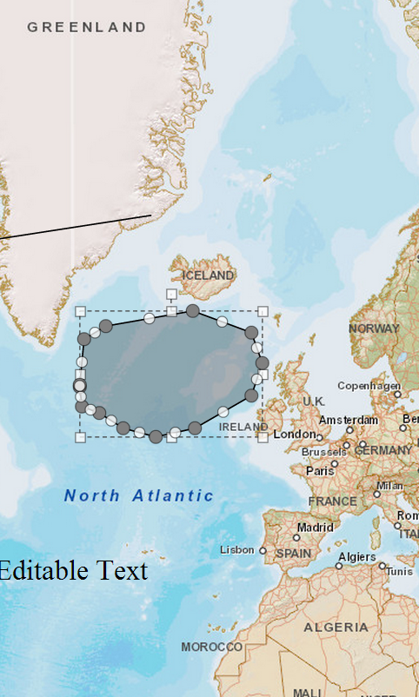
Feature Layer
Vector data (svg or canvas)
Interactive
Popups
Query (spatial and attribute)
Enables editing

Slide 7
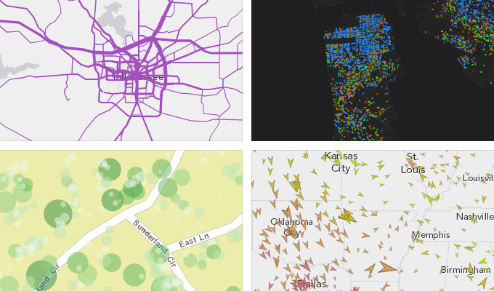
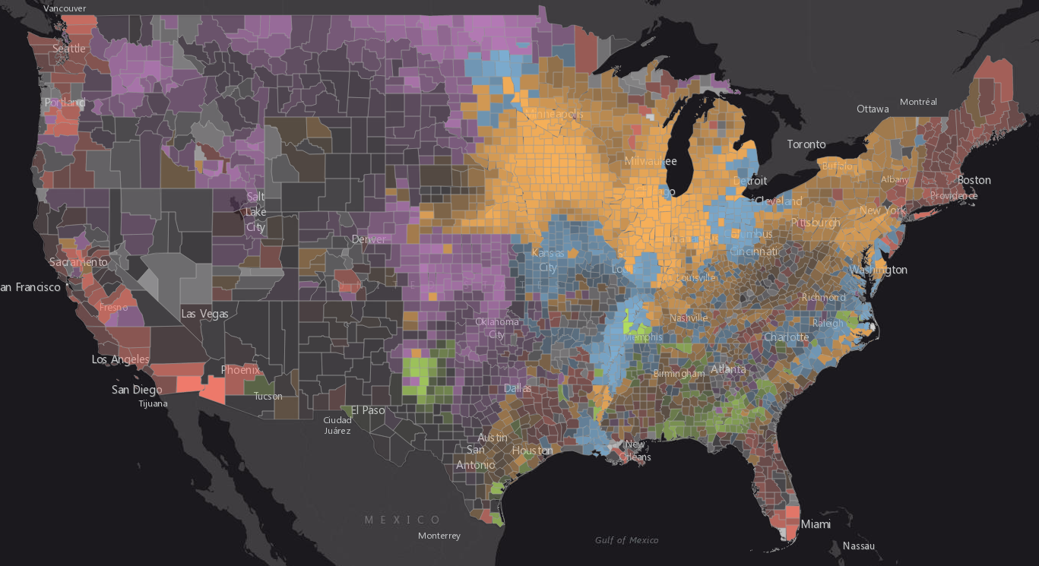
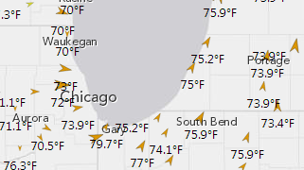
Various Ways to Visualize a Feature Layer
And More!

Slide 8

Renderers
SimpleRenderer
UniqueValueRenderer
ClassBreaksRenderer

Slide 9
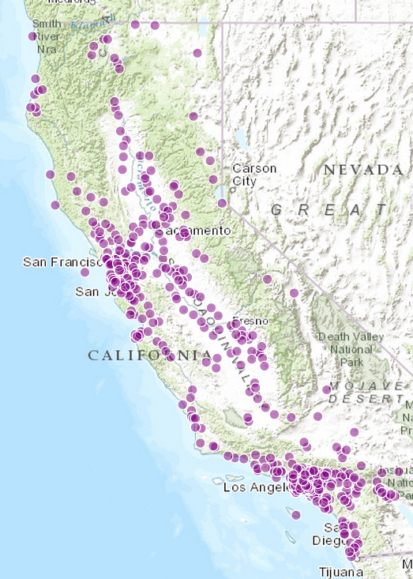
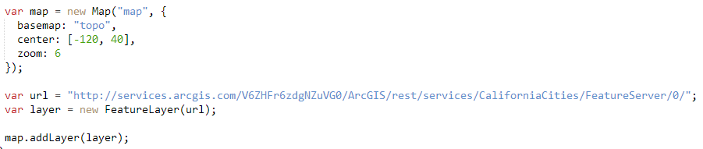
Default Feature Layer View
A feature layer has its own default symbol
Defined in the “drawingInfo” property

Slide 10
Show me where!
Single symbol, no field

Slide 11
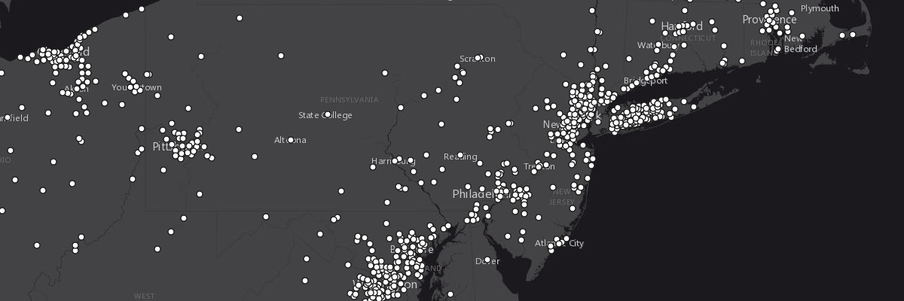
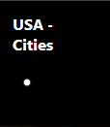
Show me where! (no field)
Simple Renderer

Slide 12
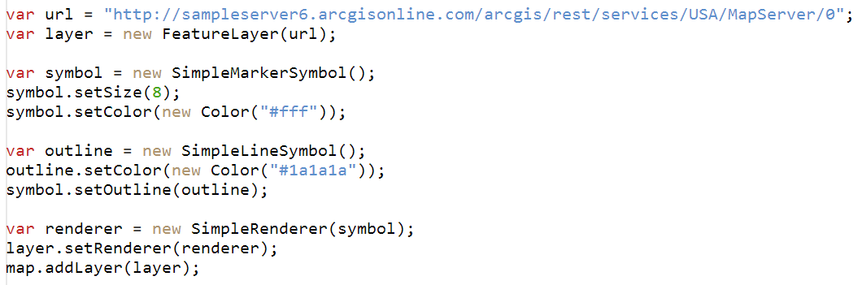
Show me where! (no field)
Simple Renderer

Slide 13
Show me what!
Based on field or expression

Slide 14
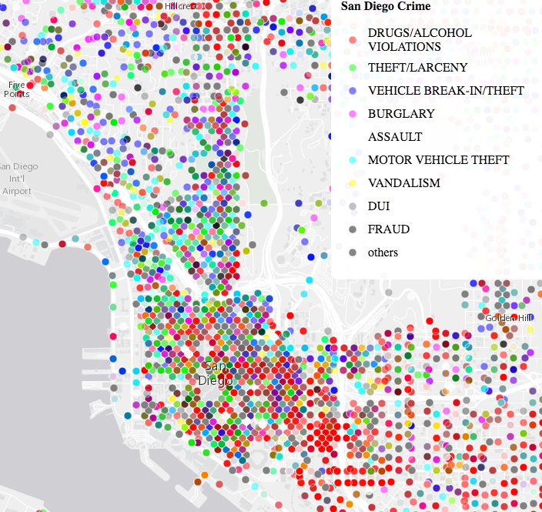
Show me what! (with field)
Unique Value Renderer

Slide 15
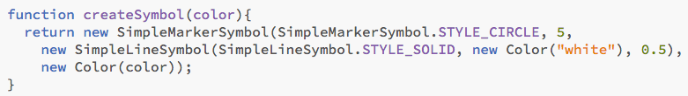
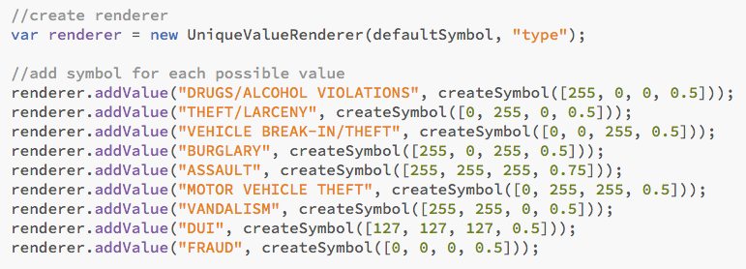
Show me what! (with field)
Unique Value Renderer

Slide 16
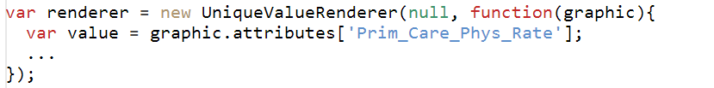
Show me what! (with expression function)

Slide 17
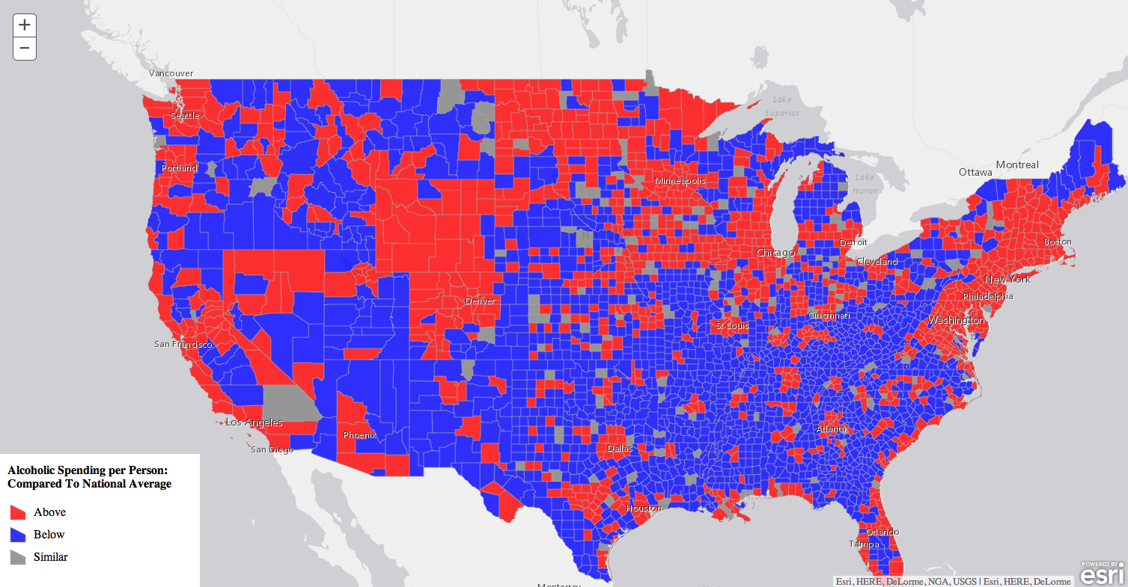
Show me what! (with expression function)– Above and Below

Slide 18
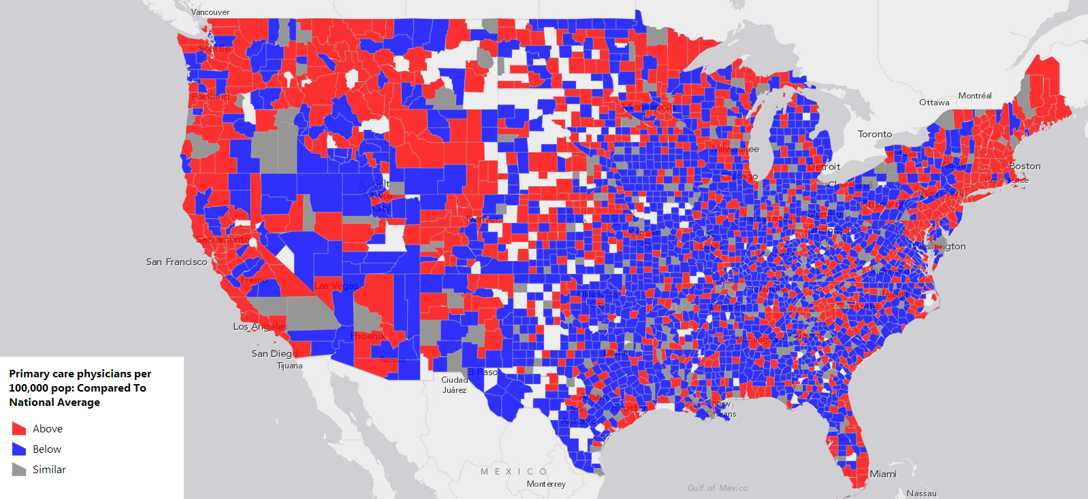
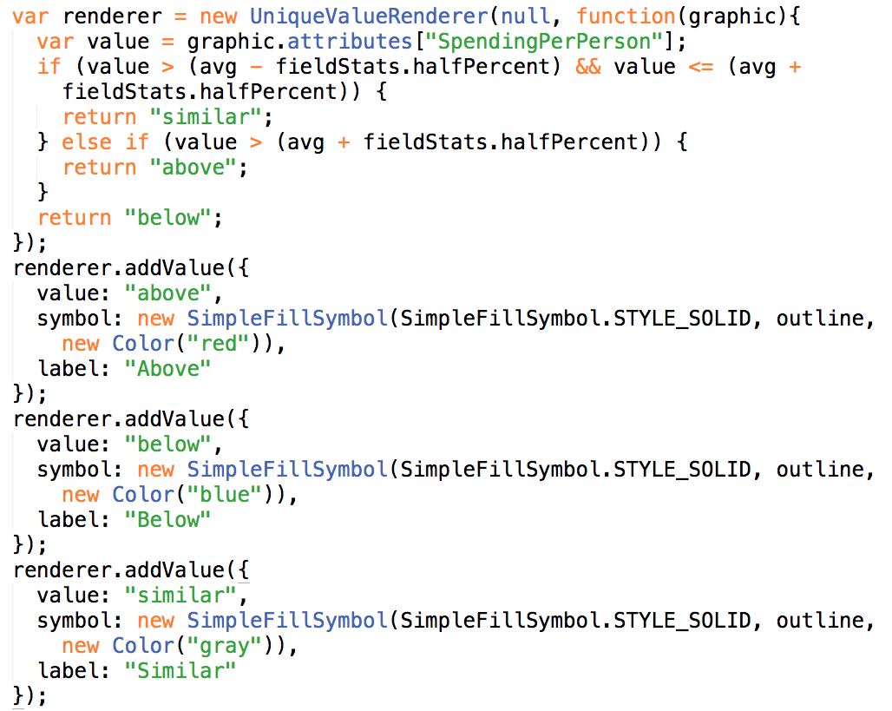
Show me what! (with expression function)– Above and Below

Slide 19
Show me how much!
Color
Size
Opacity
Also based off field value or expression

Slide 20
Parametric Properties on Renderer
rotationInfo
sizeInfo
colorInfo
opacityInfo
VisualVariables – Parameterized Symbols
Notes:
Does this still belong????

Slide 21
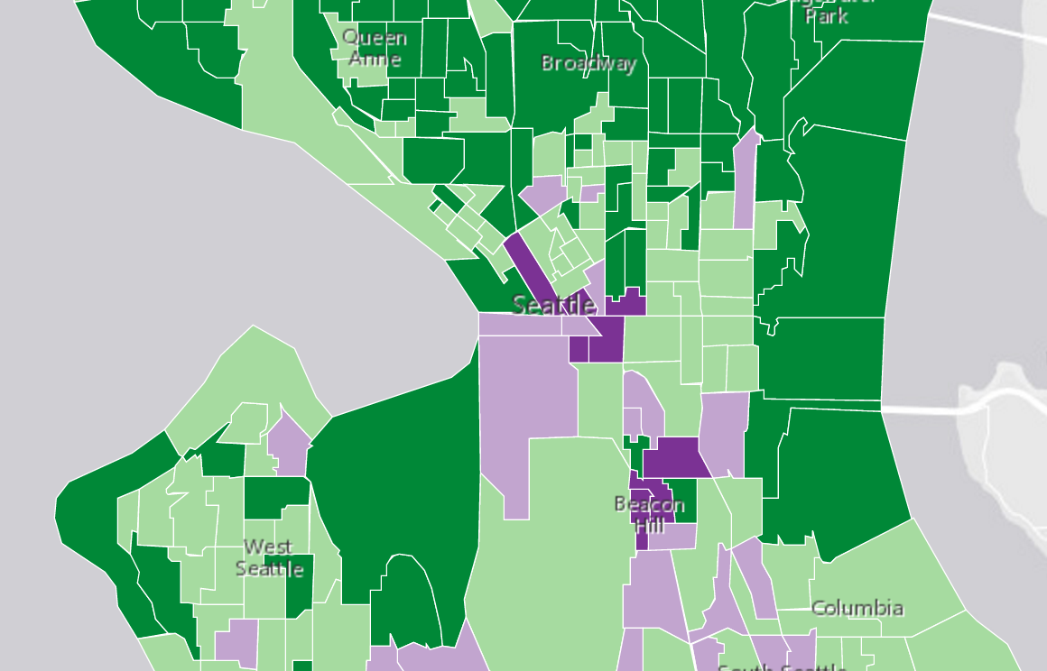
Show me how much! (classed color)
Class Breaks Renderer

Slide 22
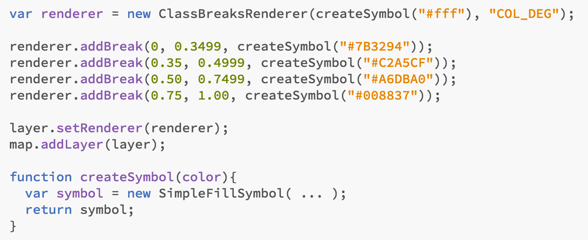
Show me how much! (classed color)
Class Breaks Renderer

Slide 23
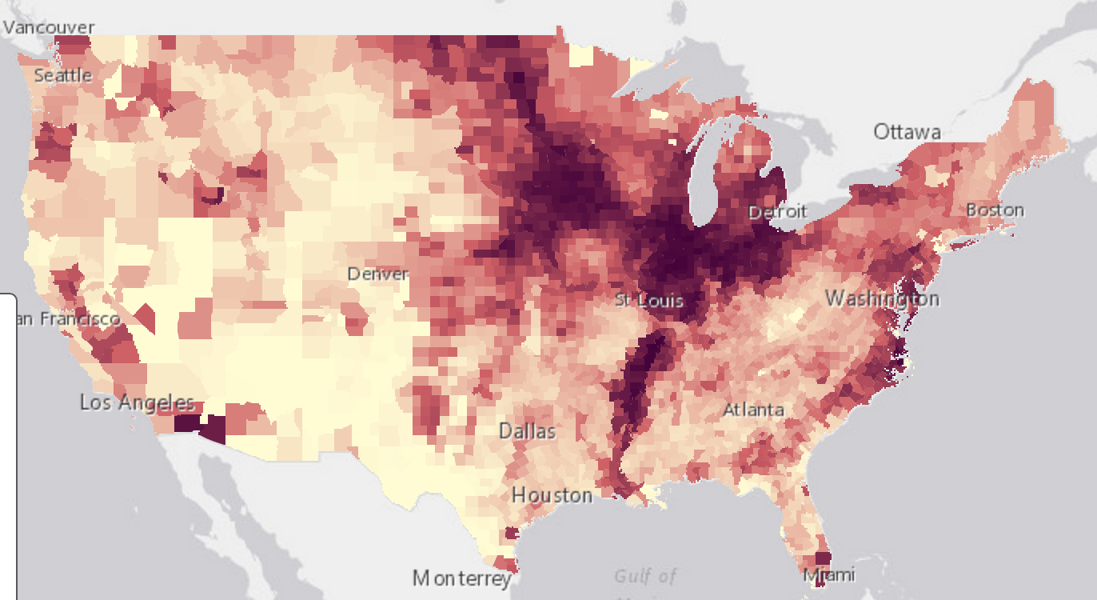
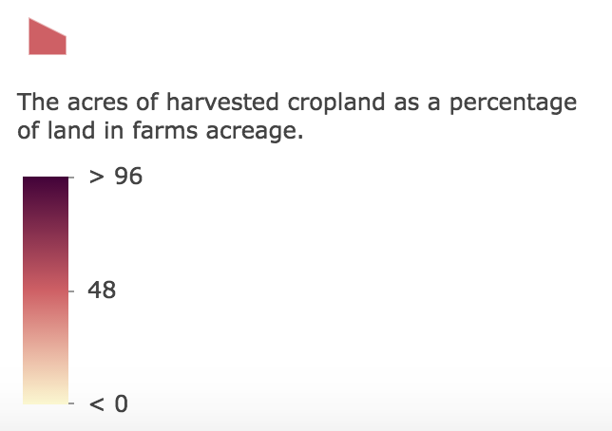
Show me how much! (continuous color)
SimpleRenderer + colorInfo

Slide 24
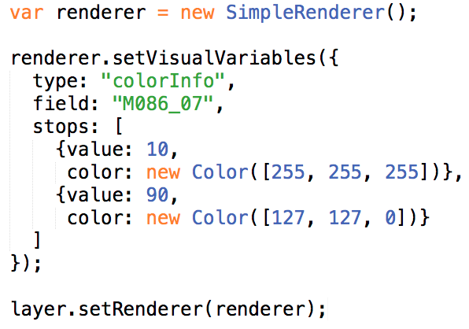
Show me how much! (continuous color)
SimpleRenderer + colorInfo

Slide 25
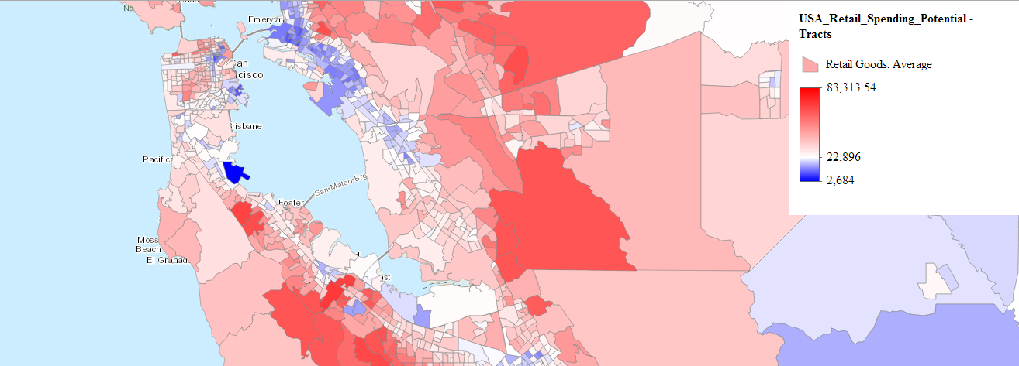
Show me how much! (color with stops)
SimpleRenderer + colorInfo

Slide 26
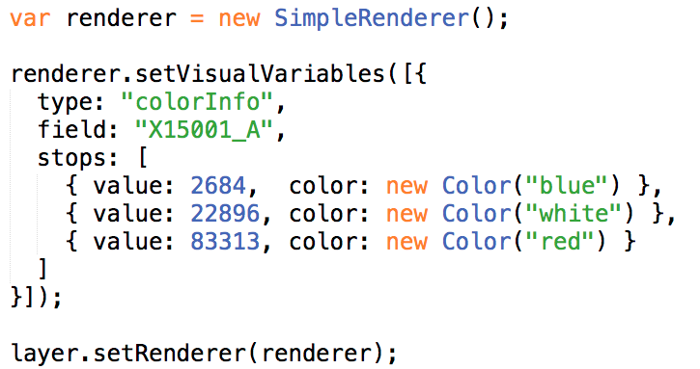
Show me how much! (color with stops)
SimpleRenderer + colorInfo
Notes:
http://servicesbeta.esri.com/jerome/uc2014/newprop-color-stops-interactive.html

Slide 27
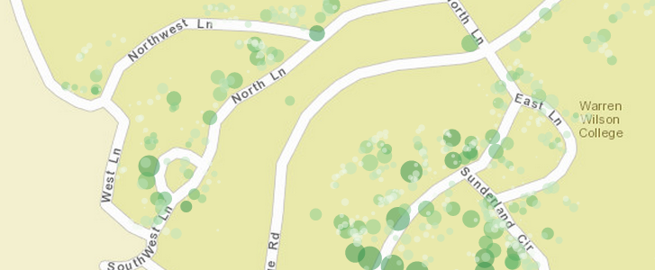
Show me how much! (size by real-world dist./area)
SimpleRenderer + SizeInfo visual variable

Slide 28
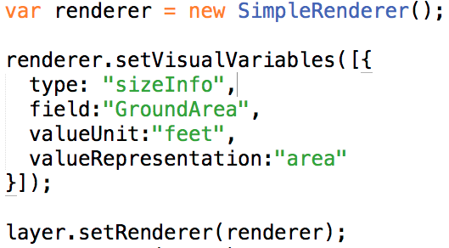
Show me how much! (size by real-world dist./area)
SimpleRenderer + SizeInfo visual variable

Slide 29
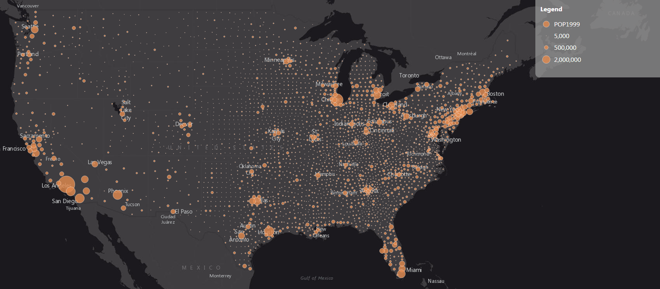
Show me how much! (truly proportional size)
SimpleRenderer + SizeInfo visual variable

Slide 30
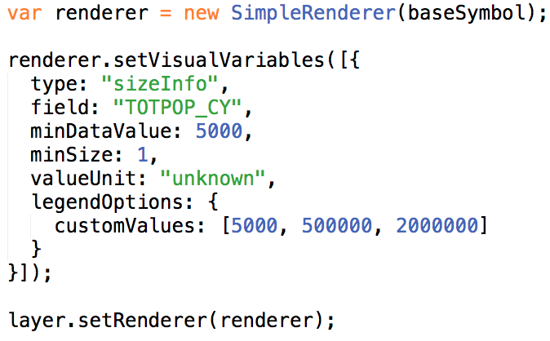
Show me how much! (truly proportional size)
SimpleRenderer + SizeInfo visual variable

Slide 31
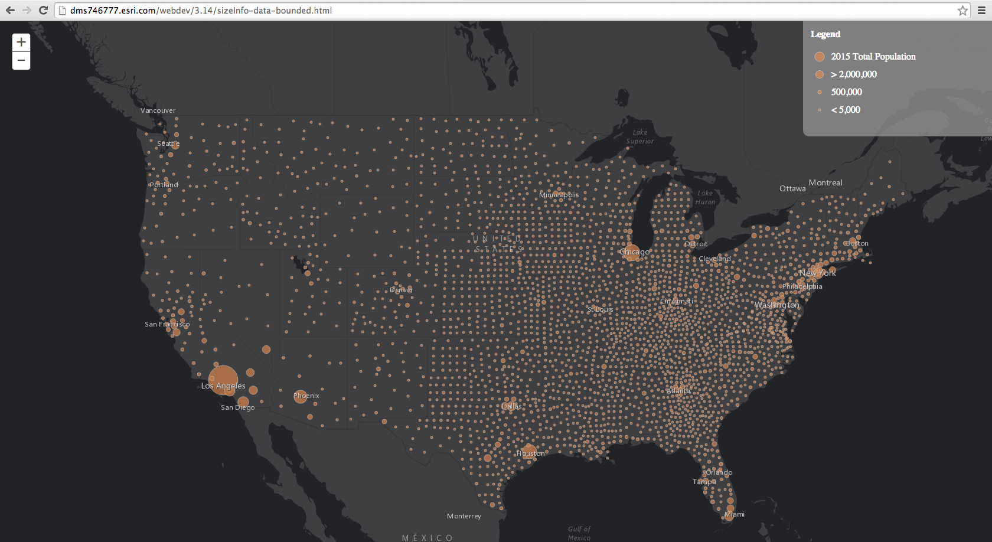
Show me how much! (continuous size - bounded)
SimpleRenderer + SizeInfo visual variable

Slide 32
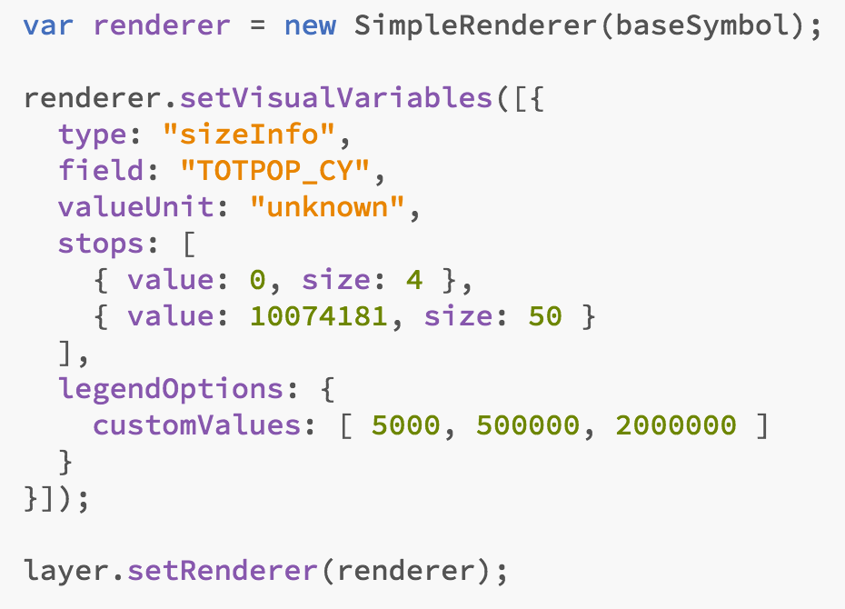
Show me how much! (continuous size - bounded)
SimpleRenderer + SizeInfo visual variable

Slide 33
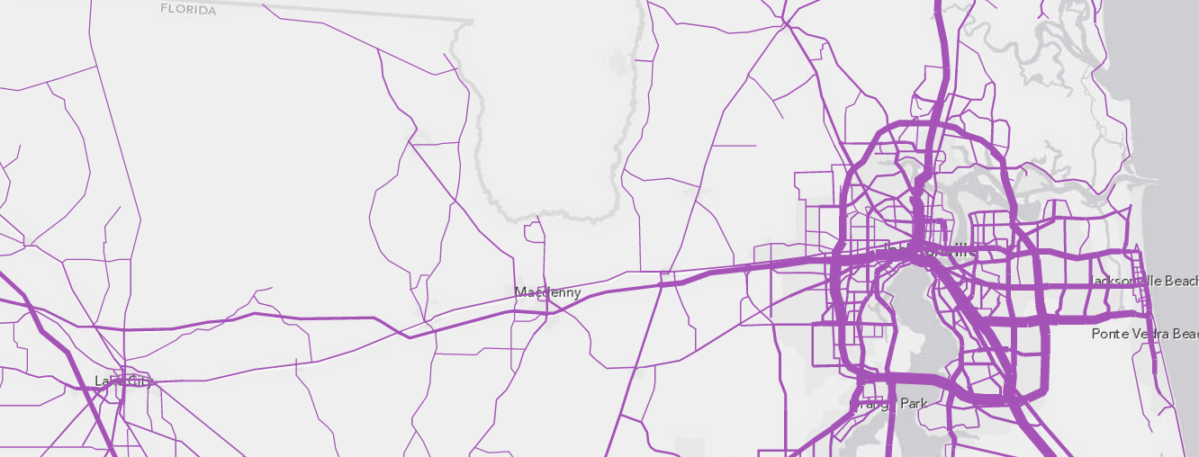
Show me how much! (bounded proportional size)
SimpleRenderer + SizeInfo visual variable
Notes:
http://developers.arcgis.com/javascript/samples/renderer_proportional_lines
http://jyang.esri.com/samples/draw-layer/proportional-slider2.html
http://developers.arcgis.com/javascript/samples/renderer_graduated_polygon/

Slide 34
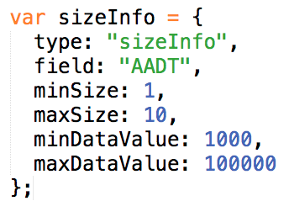
Show me how much! (bounded proportional size)
SimpleRenderer + SizeInfo visual variable
Notes:
http://developers.arcgis.com/javascript/samples/renderer_proportional_lines
http://jyang.esri.com/samples/draw-layer/proportional-slider2.html
http://developers.arcgis.com/javascript/samples/renderer_graduated_polygon/

Slide 35
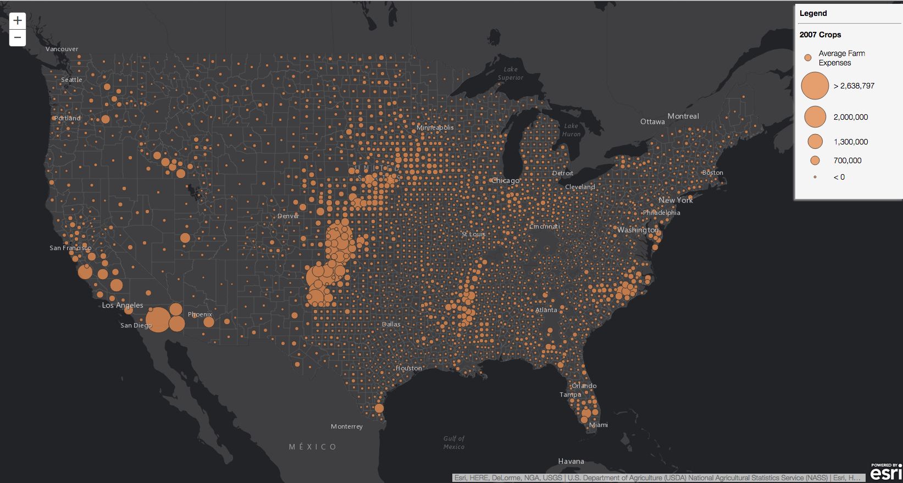
Show me how much! (scale dependent continuous size)
SimpleRenderer + SizeInfo visual variable
Map should look
good at all scales

Slide 36
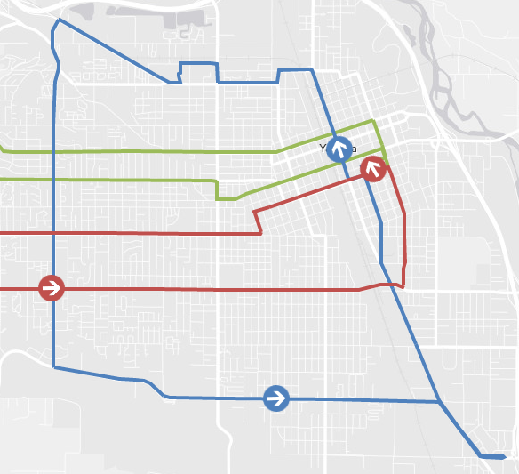
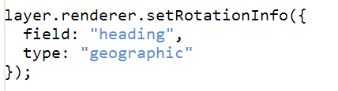
Rotation
Renderer.rotationInfo

Slide 37
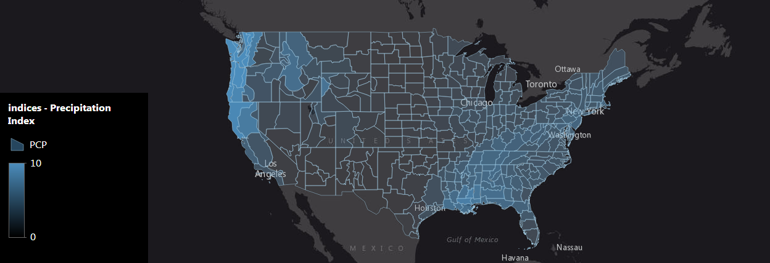
Show me how much! (continuous opacity)
SimpleRenderer + OpacityInfo visual variable

Slide 38
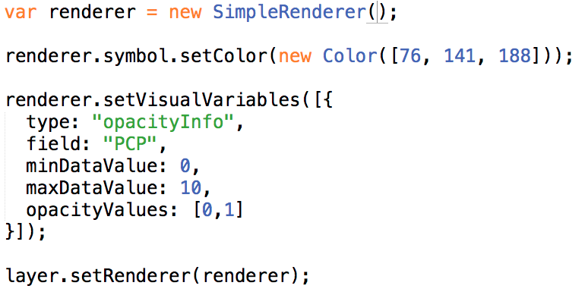
Show me how much! (continuous opacity)
SimpleRenderer + OpacityInfo visual variable

Slide 39
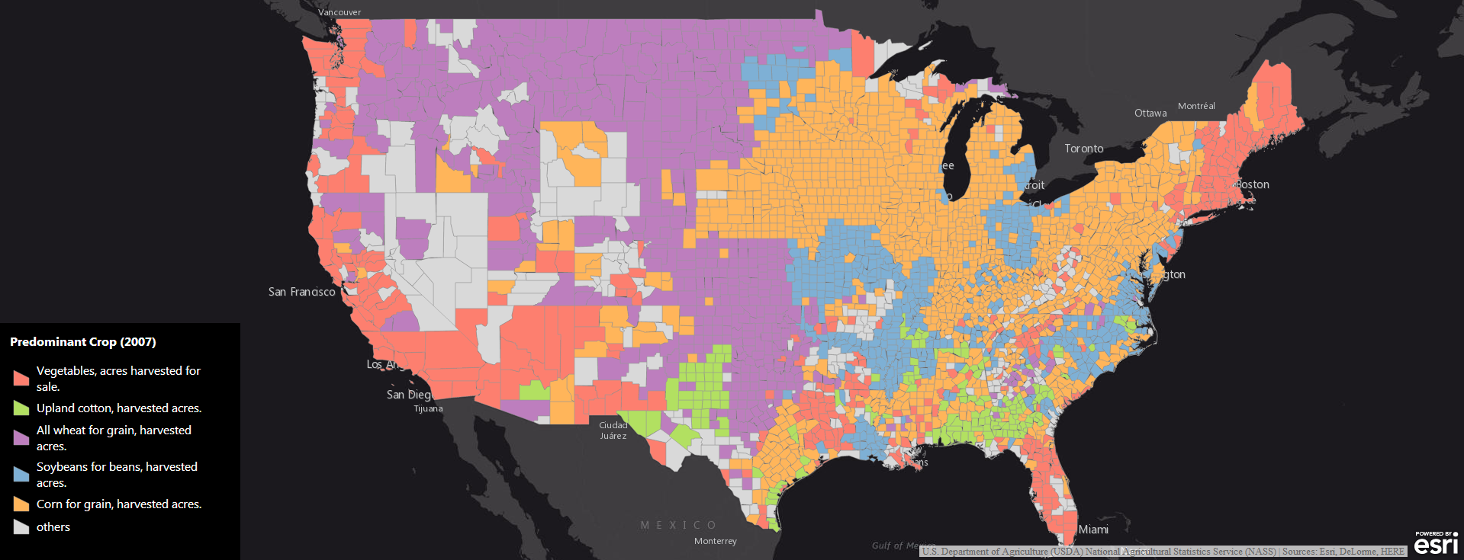
Show me how much! (continuous opacity)
UniqueValueRenderer + OpacityInfo visual variable
Notes:
[Show live sample of this one]
Show map and describe (go to the app)
Show popup for one crop, popup for another crop
Show code sample (next page)

Slide 40
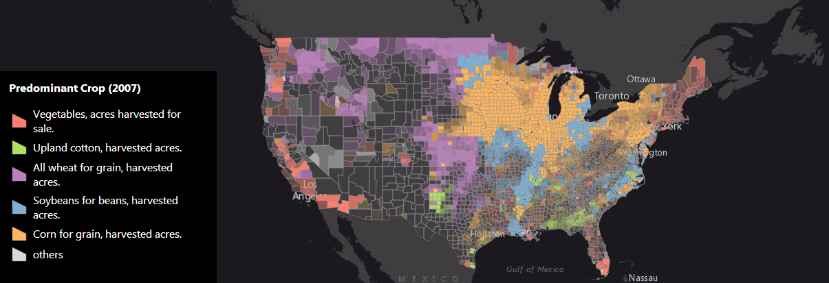
Show me how much! (continuous opacity)
UniqueValueRenderer + OpacityInfo visual variable

Slide 41
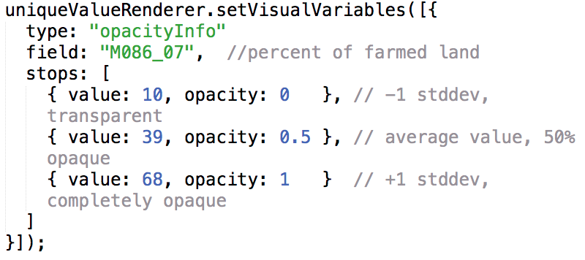
Show me how much! (continuous opacity)
UniqueValueRenderer + OpacityInfo visual variable

Slide 42
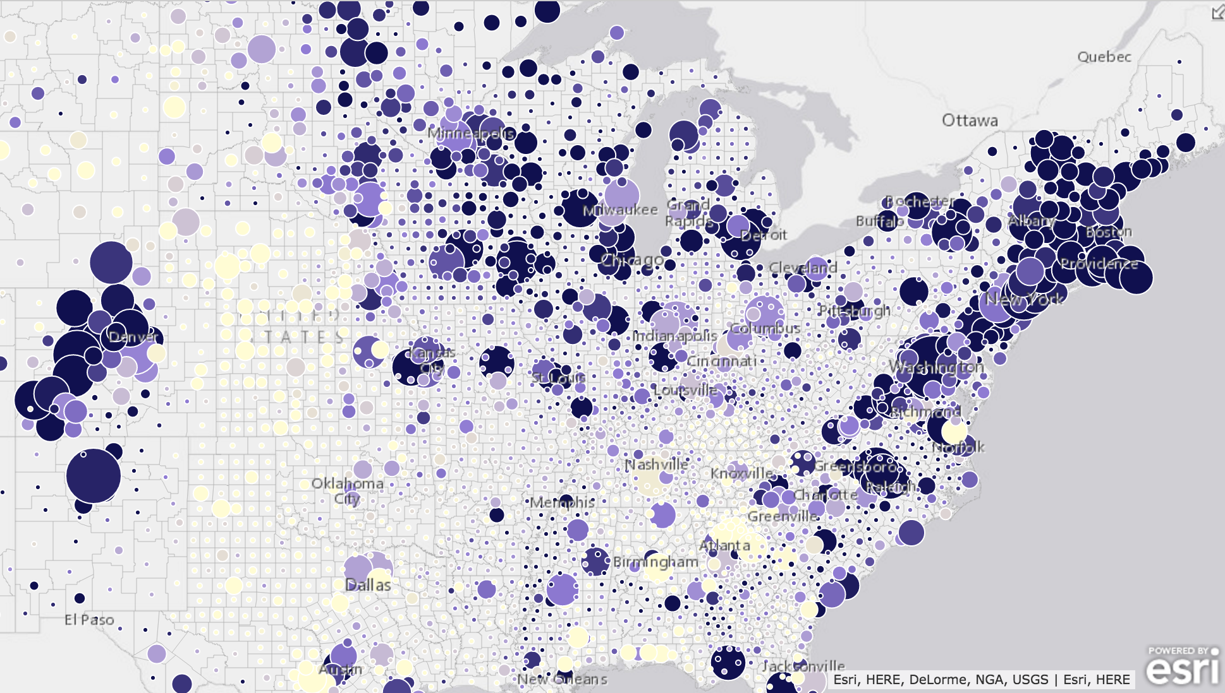
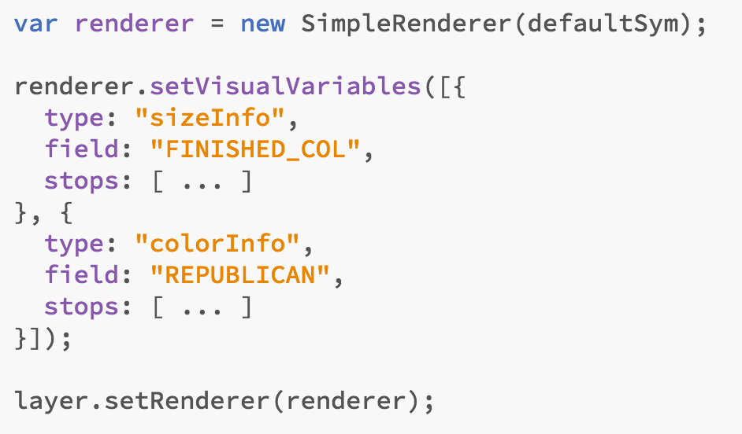
Show me potential correlation
Color + size visual variables to visualize two variables

Slide 43
Show me when
Timeline with start and end date field (continuous color)
Timeline before and after date field (diverging continuous colors)

Slide 44
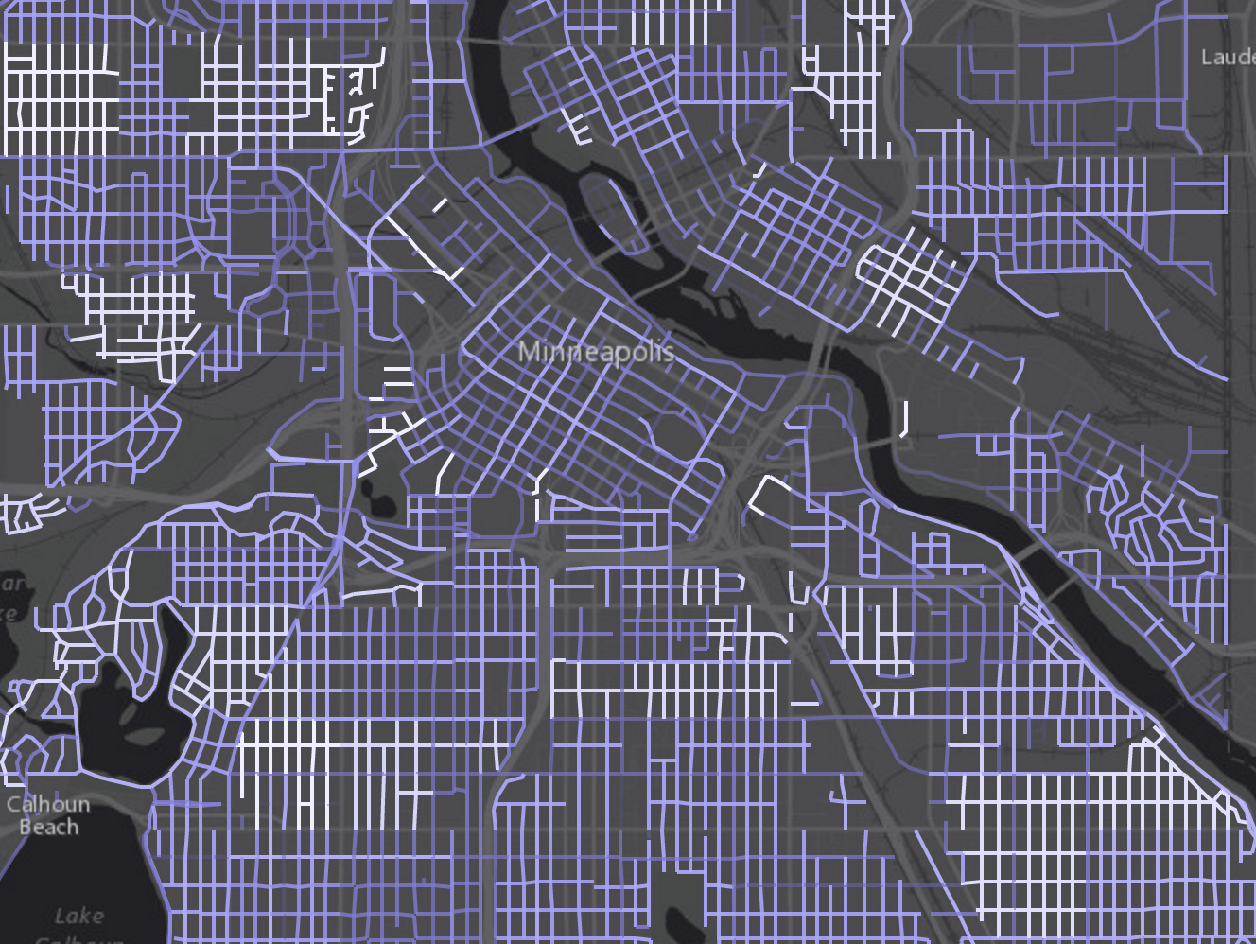
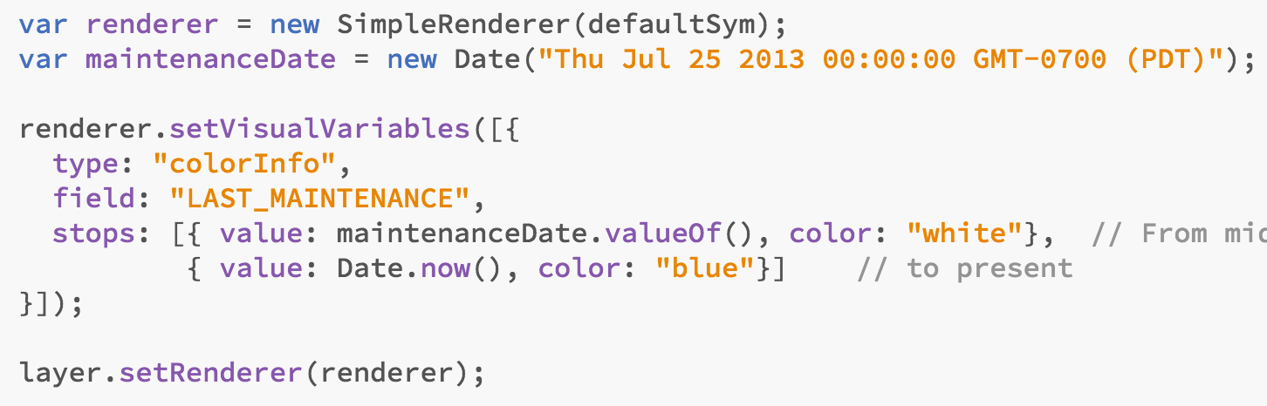
Show me when (timeline continuous color)

Slide 45
Other Renderers
DotDensityRenderer
BlendRenderer
ScaleDependentRenderer
Heatmap

Slide 46
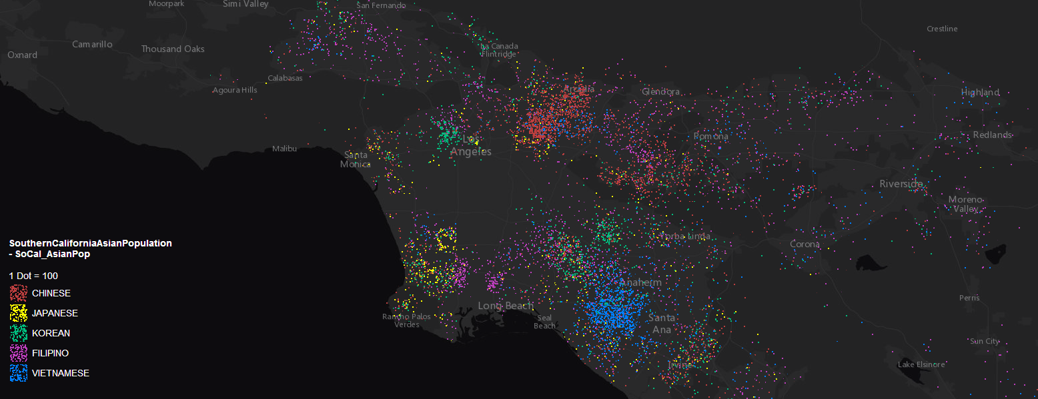
Dot Density
DotDensityRenderer

Slide 47
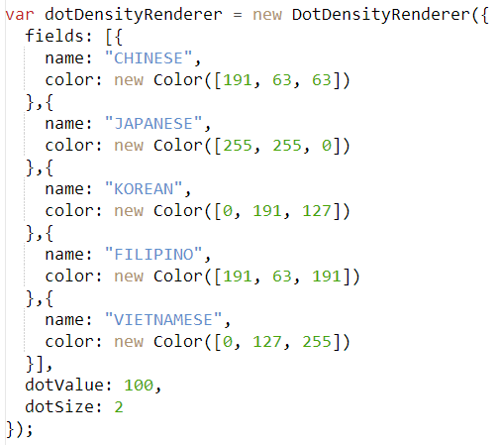
Dot Density
DotDensityRenderer

Slide 48
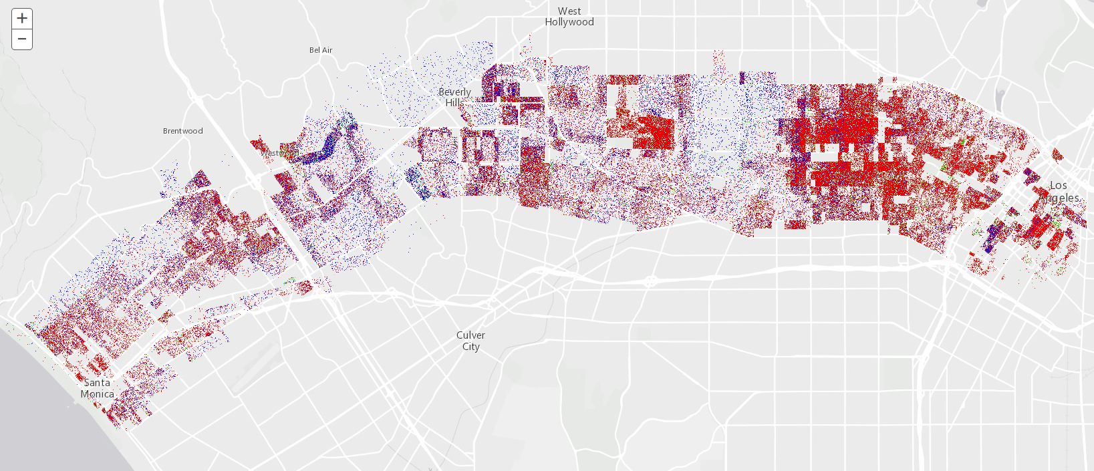
DotDensity can represent 1 dot per value

Slide 49
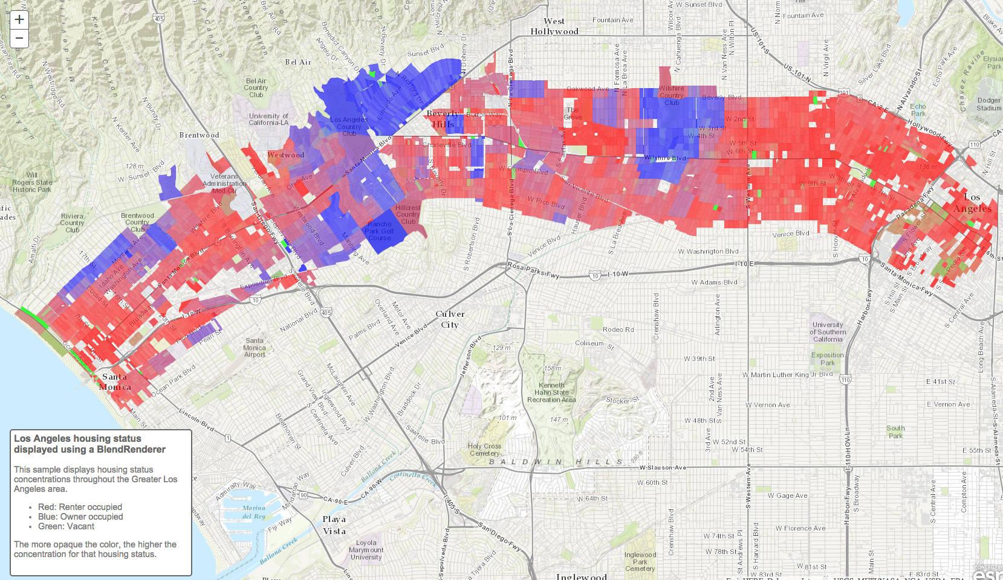
BlendRenderer -- Beta

Slide 50

BlendRenderer

Slide 51


Slide 52

Heatmap -- Renderer

Slide 53
Smart Mapping
Let your data drive your visualization

Slide 54
Smart Mapping
Data driven defaults
Introduced in 3.13
Takes the guesswork out of:
What colors to use…for fill, outline, background fill outline, etc
What opacity to use on each color
What size to use for lines, markers, outlines on markers
What size is appropriate for what scale
Does this by looking at the data, the basemap, and the story you want to tell
Used by authoring and data exploration apps

Slide 55


Smart Mapping API components -- Styles

Slide 56

Smart Mapping API components – FL Stats Plugin

Slide 57

Smart Mapping API components – FL Stats Plugin

Slide 58

Smart Mapping API components – smartMapping

Slide 59

Smart Mapping API components – smartMapping

Slide 60

Smart Mapping API components – Sliders

Slide 61


Smart Mapping API components – smartMapping

Slide 62
Smart Mapping
Goal is to help you generate the best possible visualization for your data
It is expensive to introspect your data
Best option is to let SmartMapping generate you a renderer that you use in your application statically.
The authoring experience of ArcGIS.com uses smart mapping in WebMaps

Slide 63






Please take our Survey
Jeremy Bartley jbartley@esri.com
Kristian Ekenes kekenes@esri.com
Your feedback allows us to help maintain high standards and to help presenters
Find your event in the Esri Events App
Find the session you want to review
Scroll down to the bottom of the session
Answer survey questions and submit

Slide 64



